Slide 1
BIG DATA
How do we perform analytics on big data?

Slide 2
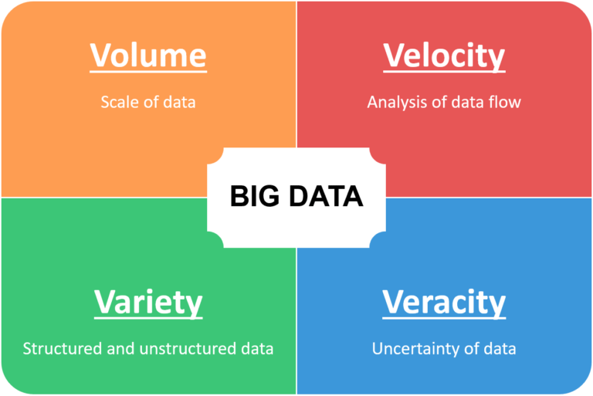
What is big data
More data than fits on your computer

Slide 3
Where to begin?
Started with a desire to learn big data analytics
What skills to focus on?
Let’s look at Stack Overflow Trends

Slide 4
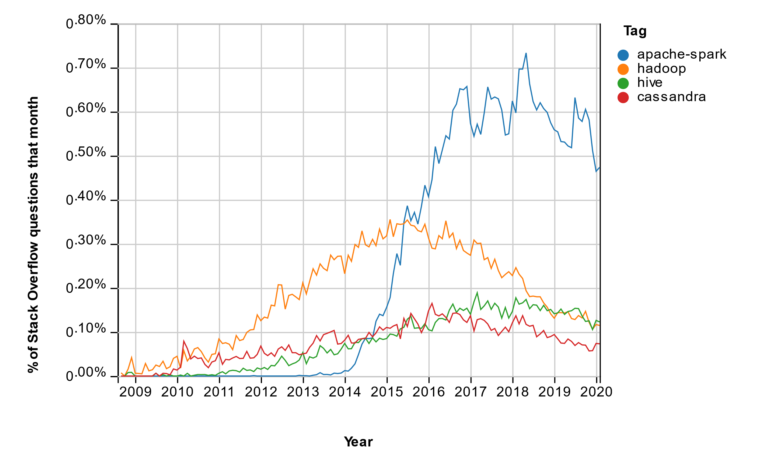
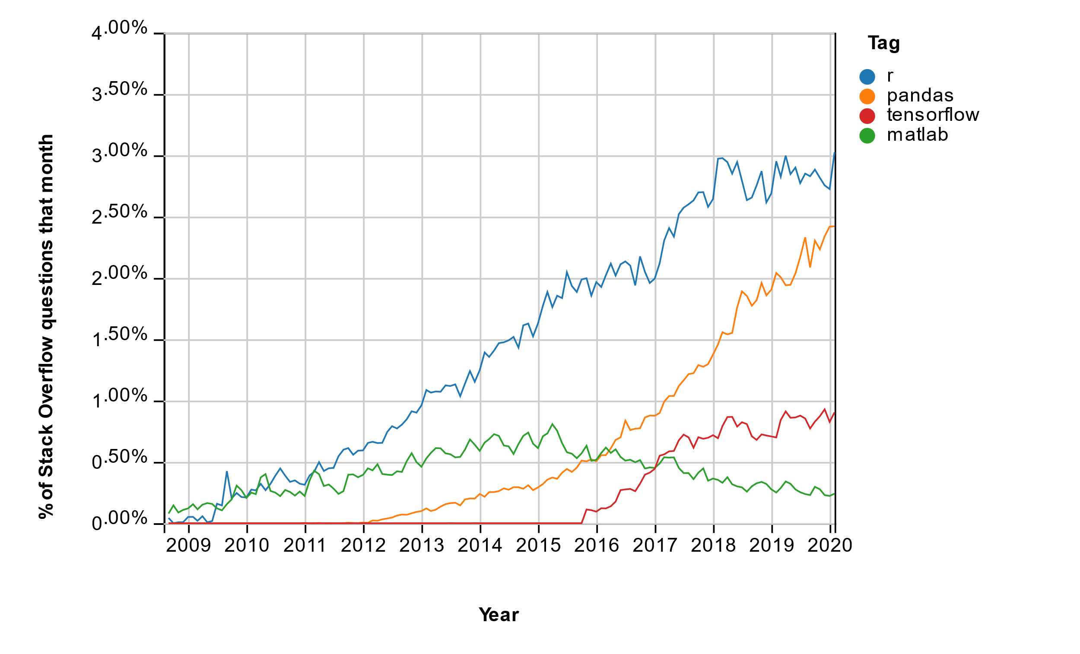
Stack Overflow Trends
Apache Open-source Projects
Data Science and Big Data

Slide 5
Set a learning path
Focus on Apache Spark using Python (PySpark)
Look for interfaces like Pandas
BUT, after several courses, there was very little consistency in
Methods used
Tools used
Realized that this is a rapidly evolving ecosystem
But before we get there …
A little diversion on how the data center has evolved

Slide 6
Evolution of the data center
Data growth and cost drove re-architecting the data center
Google and Yahoo led the effort to replace legacy infrastructure with commodity hardware
Achieve same reliability with simple replication and file system fault tolerance

Slide 7
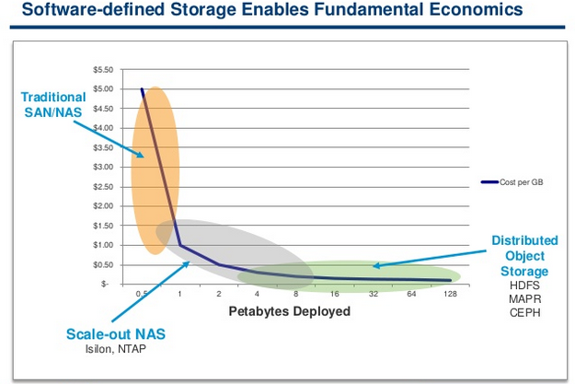
Storage Cost Comparison
Data Center costs undercut traditional IT infrastructure
Commodity hardware
Direct purchasing
Bypass traditional vendors – EMC, HP, IBM
http://www.googlinux.com/understanding-distributed-data-storage/index.html
10/3/2016

Slide 8
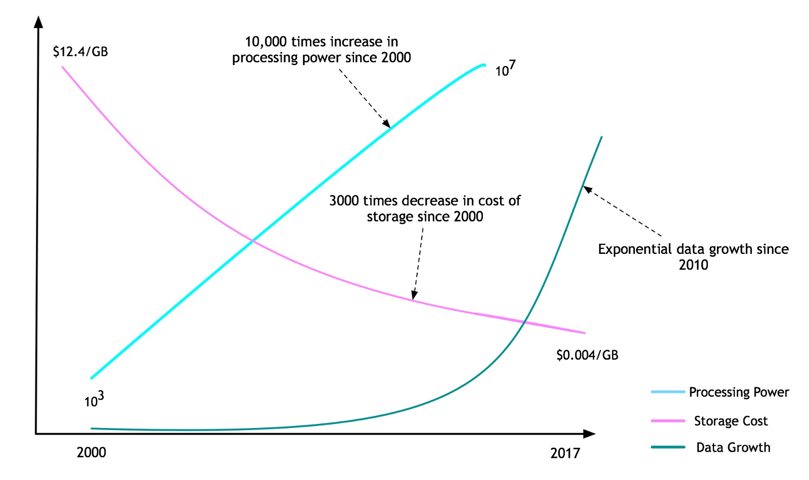
Processing and Storage Trends
Combination of processing power and storage density make individual servers powerful compute and storage devices
https://towardsdatascience.com/the-future-of-computation-for-machine-learning-and-data-science-fad7062bc27d
10/24/2019

Slide 9
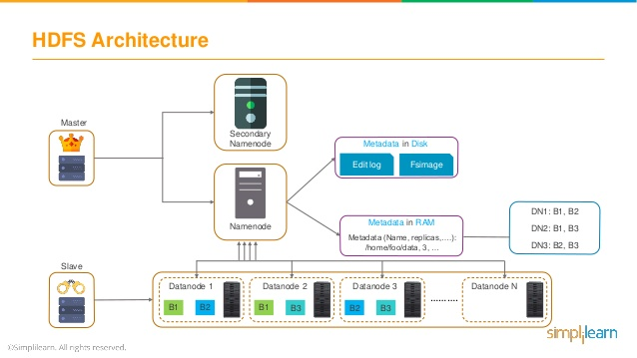
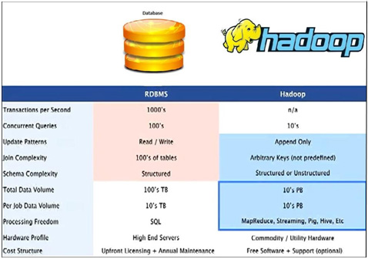
Hadoop and the Hadoop Distributed File System (HDFS)
Hadoop and HDFS (Hadoop Distributed File System) developed as open source and adopted by Yahoo in 2006
Framework to store large volumes of data on several node machines
Helps in processing the data in a parallel manner
https://www.belatrixsf.com/blog/how-to-decide-between-rdbms-and-hadoop
https://www.slideshare.net/Simplilearn/hadoop-architecture-hdfs-architecture-hadoop-architecture-tutorial-hdfs-tutorial-simplilearn
2/1/2018

Slide 10
Big Data API Evolution
MapReduce
Spark RDD
Spark Dataframes
Koalas

Slide 11
How do we access and analyze big data?
We’ve got our data in a large data center using HDFS
Now what?
Following the industry timeline, it will start with low level programming and work towards higher level techniques
Goal seems to be enabling data scientists, not just software engineers work directly with the data (Pandas)

Slide 12
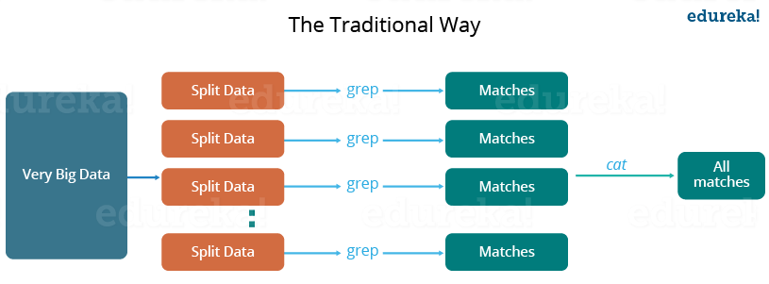
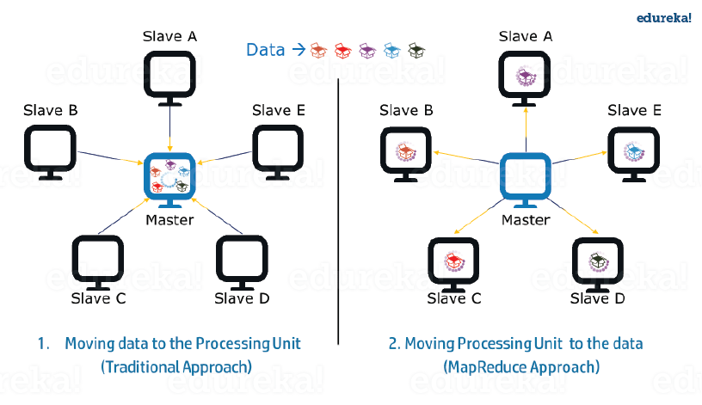
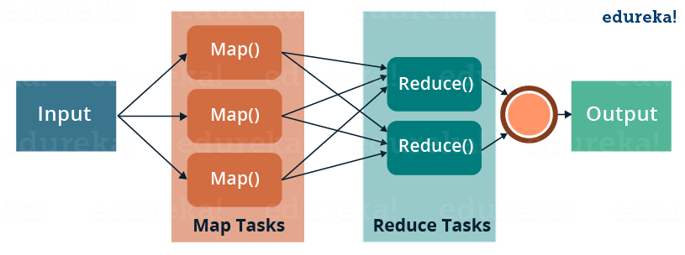
MapReduce – improve parallelism
Invented by Google (2004)
Both map and reduce operations occur on compute node with data partition
Only the reduced results are sent to master
Reduces network traffic and latency
MapReduce moves the processing to the data
MapReduce

Slide 13
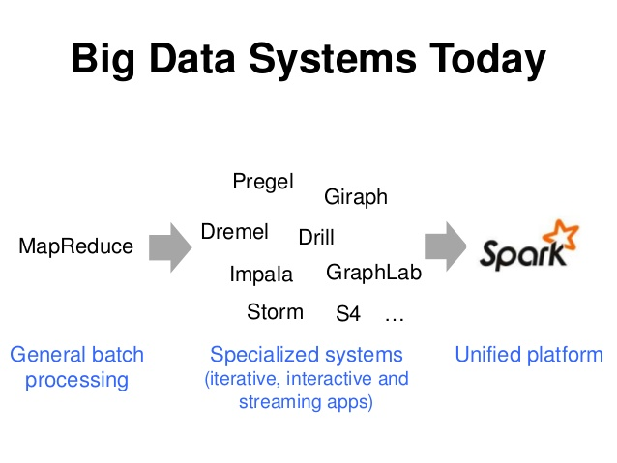
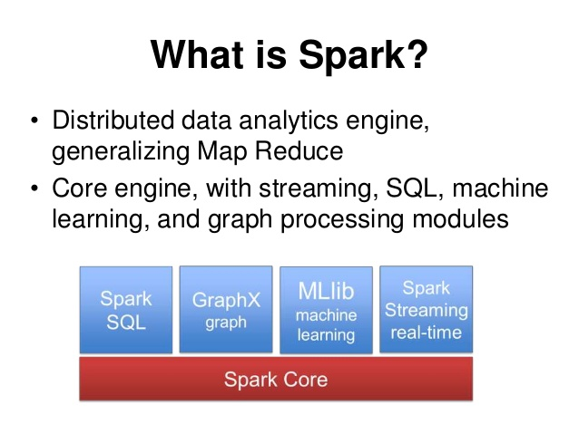
Apache Spark
Invented by UC Berkeley (2009)

Slide 14
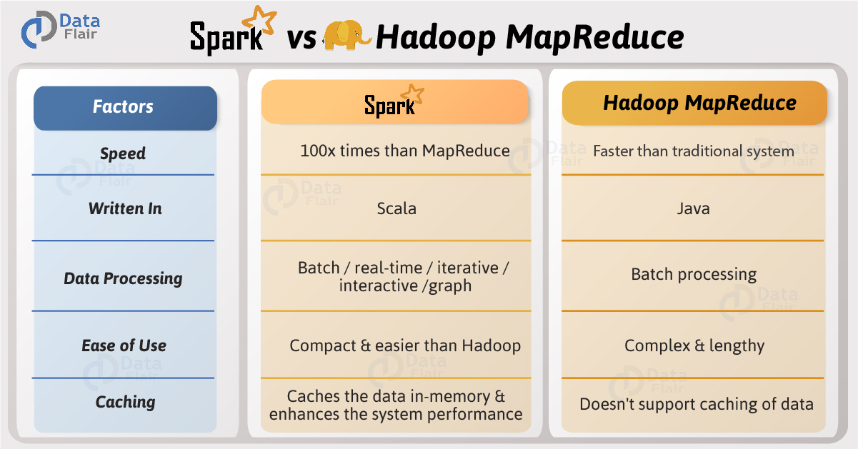
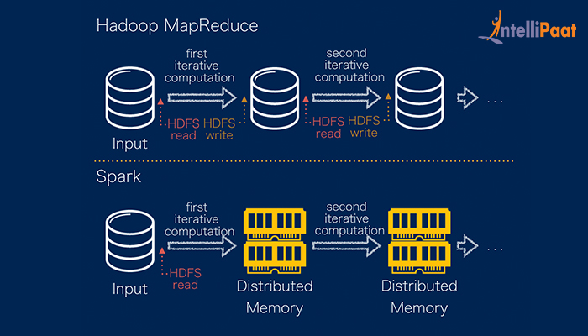
Why Spark
Better for iterative analysis (machine learning)

Slide 15
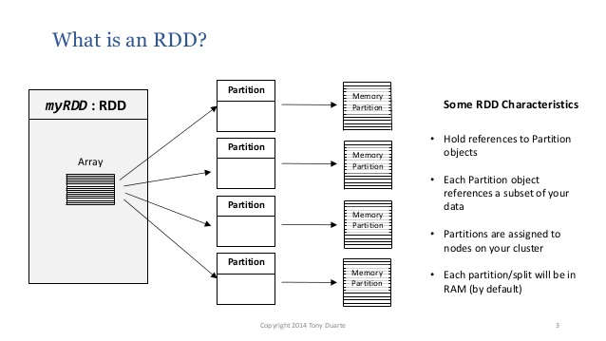
Sparks fundamental data structure - Resilient Distributed Datasets (RDD)
Code example
val readme = sc.textFile("/resources/jupyterlab/labs/BD0211EN/LabData/README.md")
val wordCounts = readme.flatMap(line => line.split(" ")).map(word => (word, 1)). reduceByKey((a,b) => a + b)

Slide 16
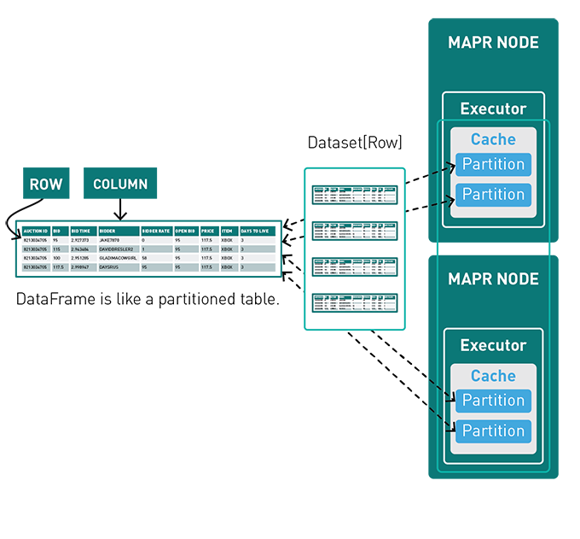
Spark DataFrames and Datasets
Introduced to Spark in 2016
Infer some structure (schema) on the data
Rows (observations)
Columns (variables)
Intended to mimic behavior of statistical software – R, Stata, and Python Pandas
Easier to use than RDD, but still clunky
Requires list comprehension to extract data

Slide 17
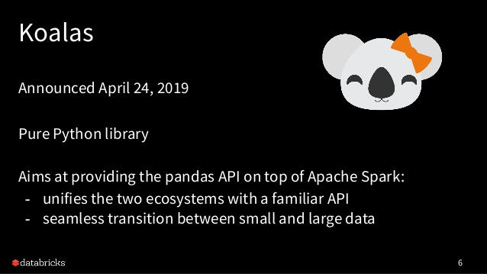
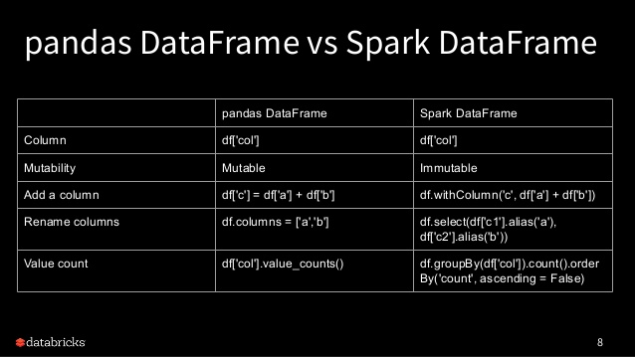
Koalas – merge the ecosystem of data scientists
Add comment
https://databricks.com/session_eu19/koalas-pandas-on-apache-spark
10/31/2019

